Slide 1
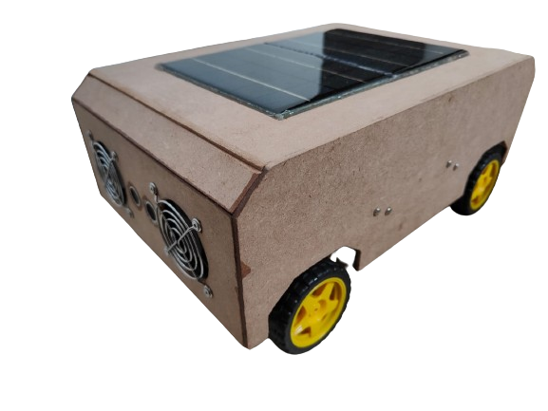
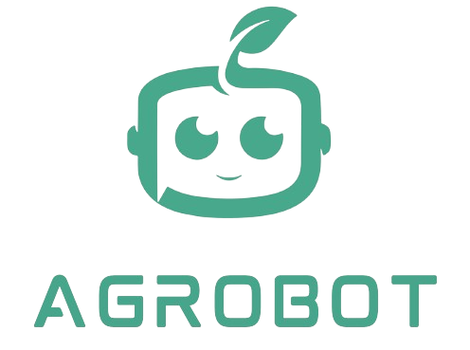
Team Members:
Atharva Shewale
Tanay Rambhia
Soham Sonavane

Slide 2
POINTS TO BE COVER
PROBLEM STATEMENT
JOYSTICK
FUNCTIONS
MONITORING
ANALYSIS

Slide 3
PROBLEM STATEMENT
Agricultural practices face challenges in implementing advanced monitoring systems, particularly integrating specialized robots with diverse sensors and real-time weather data
The project proposes an advanced agricultural monitoring system that uses a robot, sensors, and real-time weather data to optimize resource utilization, improve crop management using the app

Slide 4
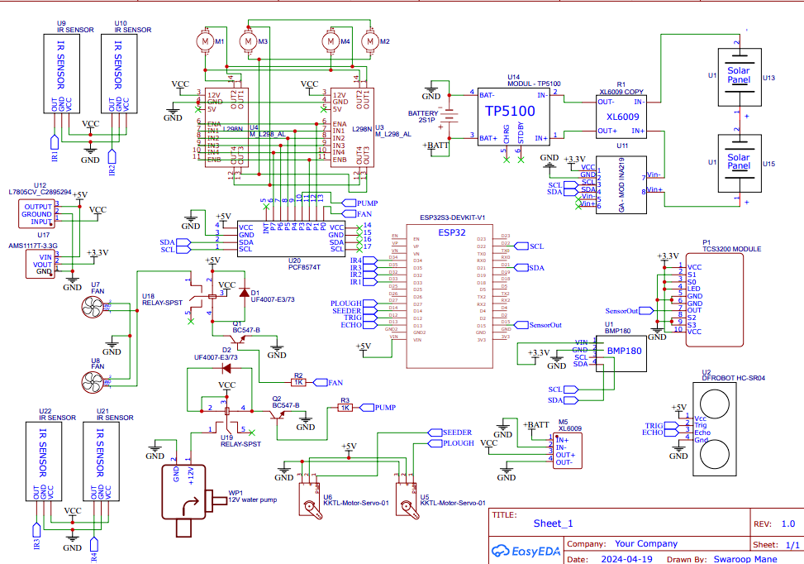
CIRCUIT DIAGRAM

Slide 5
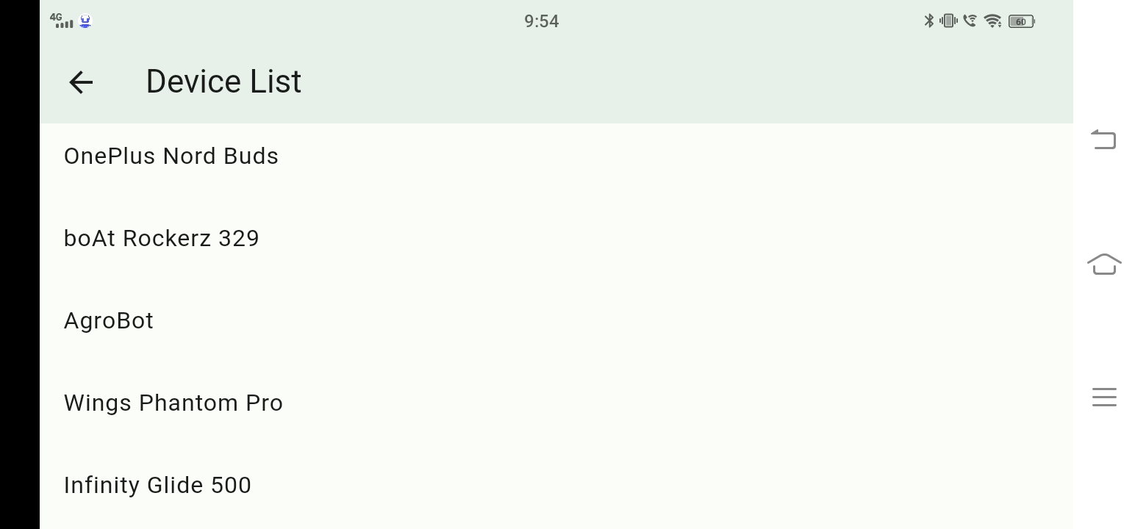
Bluetooth
CODE
import 'package:flutter_bluetooth_serial/flutter_bluetooth_serial.dart’;
void _startScan() {
FlutterBluetoothSerial.instance.getBondedDevices().then((List<BluetoothDevice> bondedDevices) {
setState(() {
devices.addAll(bondedDevices);
});
});
FlutterBluetoothSerial.instance.startDiscovery().listen((BluetoothDiscoveryResult result) {
setState(() {
if (!devices.contains(result.device)) {
devices.add(result.device);
}
});
}, onError: (dynamic error) {
debugPrint("Error during device discovery: $error");
});
}
void _connectToDevice(BluetoothDevice device) async {
try {
BluetoothConnection connection = await BluetoothConnection.toAddress(device.address);
setState(() {
this.connection = connection;
});
Navigator.pushReplacement(
context,
GUI
MaterialPageRoute(builder: (context) => NextScreen(connection: connection)),
);
} catch (e) {
debugPrint('Error connecting to device: $e');
// Handle connection error
}
}

Slide 6
JOYSTICK
HARDWARE – SIDE CODE
SOFTWARE – SIDE CODE
pcf.digitalWrite(right_en, HIGH);
pcf.digitalWrite(left_en, HIGH);
anticrash();
turbidity();
if (SerialBT.available()) {
String data = SerialBT.readStringUntil('\n');
Serial.println(data);
if (data.length() > 0) {
int xPos = data.indexOf("X:");
int yPos = data.indexOf("Y:");
if (xPos != -1 && yPos != -1) {
int x = data.substring(xPos + 2, yPos).toInt();
int y = data.substring(yPos + 2).toInt(); // explain
Serial.print("X: ");
Serial.print(x);
Serial.print(", Y: ");
Serial.println(y);
if(y > 150)
{
backward();
}
else if((y < 100) && (distanceCM > 30))
{
forward();
}
else if(x > 170)
{
right();
}
else if(x < 100)
{
left();
}
else
{
neutral();
}
}
}
import 'package:flutter_joystick/flutter_joystick.dart’;
Joystick(
mode: JoystickMode.all,
listener: (details) {
// Update the x and y values when joystick moves
setState(() {
_x = details.x;
_y = details.y;
});
// Send the x and y values to the connected device
sendMessageToJoyStick("X: ${scaleTo255(_x)}, Y: ${scaleTo255(_y)}");
},
),
int scaleTo255(double value) {
// Map the value from -1 to 1 to -255 to 255
return ((value + 1) / 2 * 255).round().clamp(0, 255);
}

Slide 7
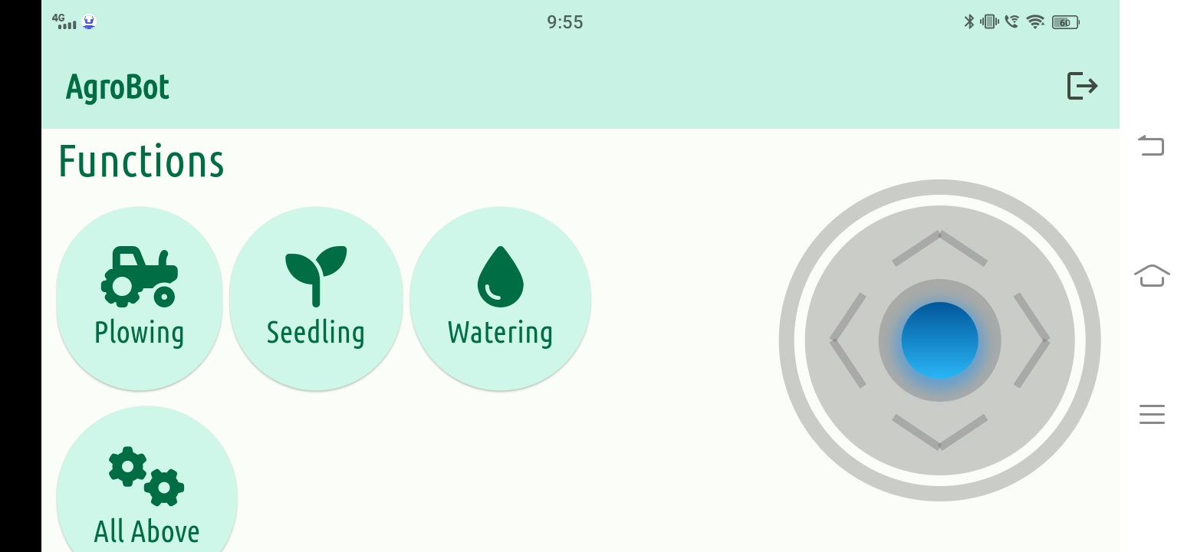
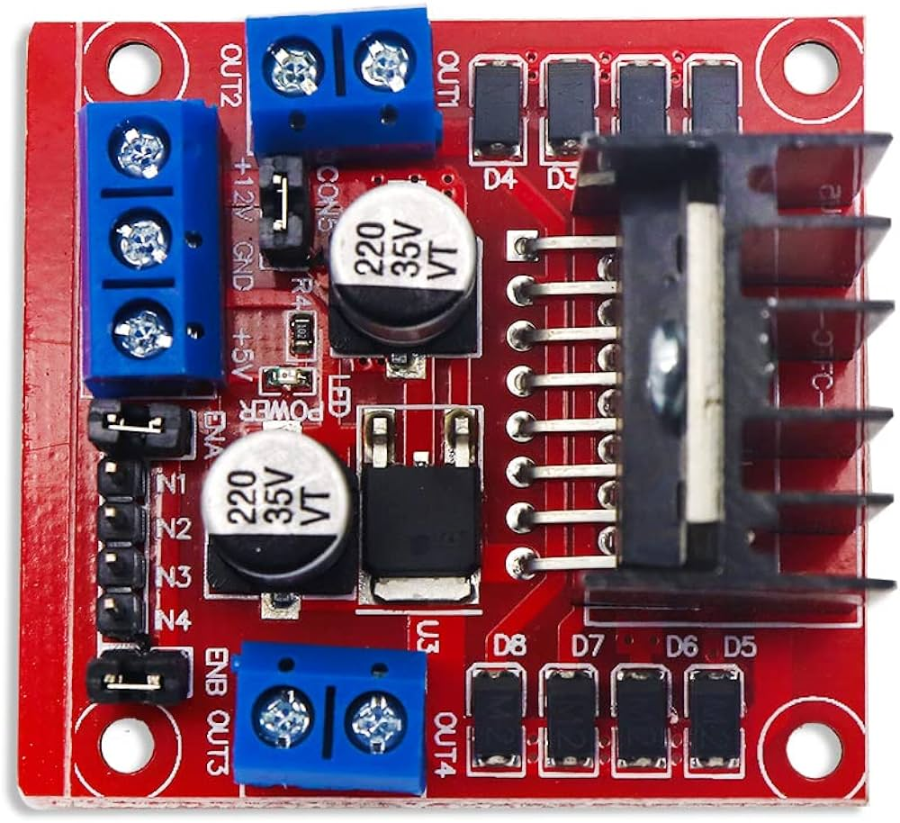
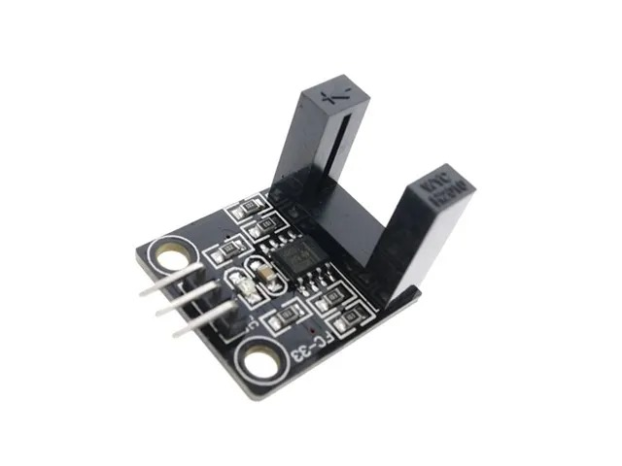
HARDWARE – SIDE CODE
GUI
void forward()
{
pcf.digitalWrite(right_fwd, LOW);
pcf.digitalWrite(left_fwd, LOW);
pcf.digitalWrite(right_bck, HIGH);
pcf.digitalWrite(left_bck, HIGH);
}
void backward()
{
pcf.digitalWrite(right_fwd, HIGH);
pcf.digitalWrite(left_fwd, HIGH);
pcf.digitalWrite(right_bck, LOW);
pcf.digitalWrite(left_bck, LOW);
}
void right()
{
pcf.digitalWrite(right_fwd, HIGH);
pcf.digitalWrite(left_fwd, LOW);
pcf.digitalWrite(right_bck, LOW);
pcf.digitalWrite(left_bck, HIGH);
}
void left()
{
pcf.digitalWrite(right_fwd, LOW);
pcf.digitalWrite(left_fwd, HIGH);
pcf.digitalWrite(right_bck, HIGH);
pcf.digitalWrite(left_bck, LOW);
}
void neutral()
{
pcf.digitalWrite(right_fwd, HIGH);
pcf.digitalWrite(left_fwd, HIGH);
pcf.digitalWrite(right_bck, HIGH);
pcf.digitalWrite(left_bck, HIGH);
}
HARDWARE
Motor Driver
IR ENCODER

Slide 8
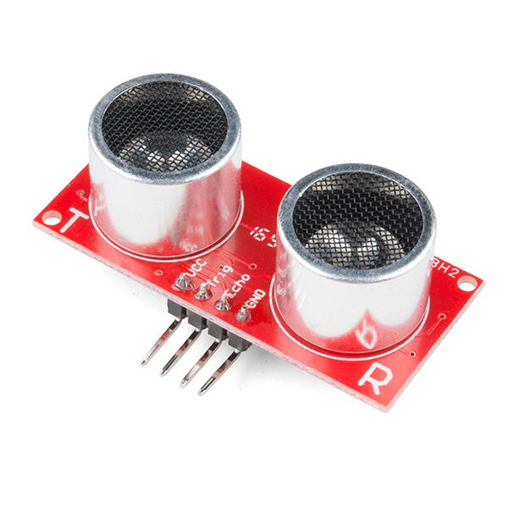
Obstacle-Avoiding
CODE
HARDWARE
void anticrash() {
unsigned long currentTime = millis();
// Read the distance from the ultrasonic sensor every 100 milliseconds
if (currentTime - lastReadTime >= 100) {
distanceCM = ultrasonic.getDistanceCM(); // Read the distance in centimeters
lastReadTime = currentTime; // Update the last read time
}
}
ULTRASONIC SENSOR

Slide 9
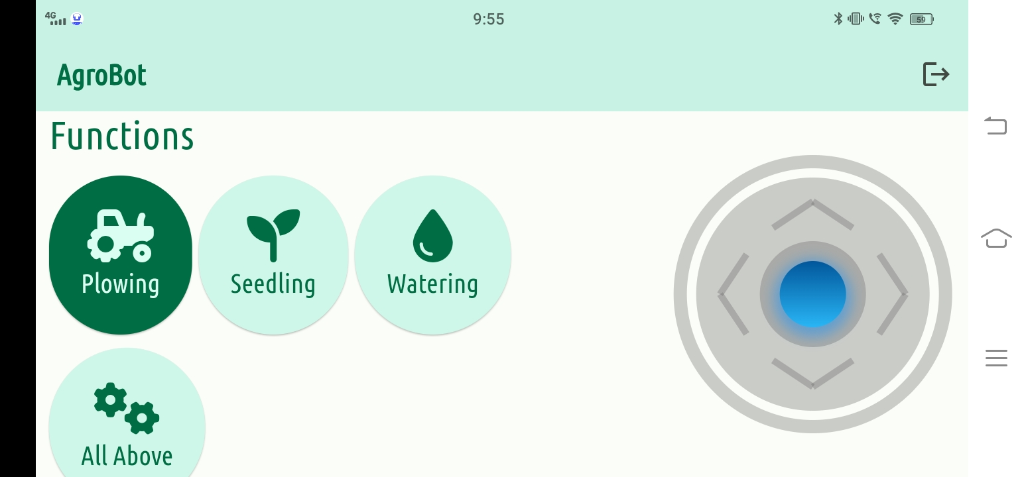
FUNCTIONS : PLOWING
SOFTWARE – SIDE CODE
GUI
void sendMessage(String msg) {
String message = msg;
if (widget.connection != null) {
widget.connection!.output.add(utf8.encode(message));
widget.connection!.output.allSent.then((_) {
// Message sent successfully
debugPrint('Message sent: $message');
}).catchError((error) {
// Error occurred while sending message
debugPrint('Error sending message: $error');
});
} else {
// Connection is null, handle accordingly
debugPrint('Bluetooth connection is not available');
}
}
sendMessage("0xA");
else
{
SerialBT.println("Plough Deactivated");
}
}
void servoplough()
{
if(isServoPloughActive == 1)
{
Plough.write(35);
}
else
{
Plough.write(180);
}
}
HARDWARE – SIDE CODE
if(data == "0xA")
{
isServoPloughActive = !isServoPloughActive;
SerialBT.println("\n");
if(isServoPloughActive == 1)
{
SerialBT.println("Plough Activated");
}

Slide 10
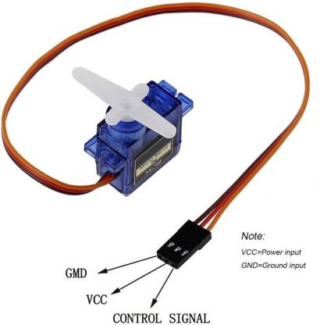
FUNCTIONS :SEEDING
HARDWARE – SIDE CODE
HARDWARE
else if (data == "0xB") {
// Toggle ServoSeed() function
isServoSeedActive = !isServoSeedActive;
SerialBT.println("\n");
if(isServoSeedActive == 0)
{
SerialBT.println("Seeder Deactivated");
}
else if(isServoSeedActive == 1)
{
SerialBT.println("Seeder Activated");
}
}
void servoseed()
{
// Increment or decrement the servo position within the range of 0 to 45 degrees
if (servo1Pos == 0) {
servo1Pos = 45;
} else {
servo1Pos = 0;
}
Seeder.write(servo1Pos);
}
SERVO MOTOR
SOFTWARE– SIDE CODE
ButtonDesign(
text1: 'Seedling',
iconData: FontAwesomeIcons.seedling,
text2: 'Seedling Started',
onPressed: () {
sendMessage("0xB");
},
),

Slide 11
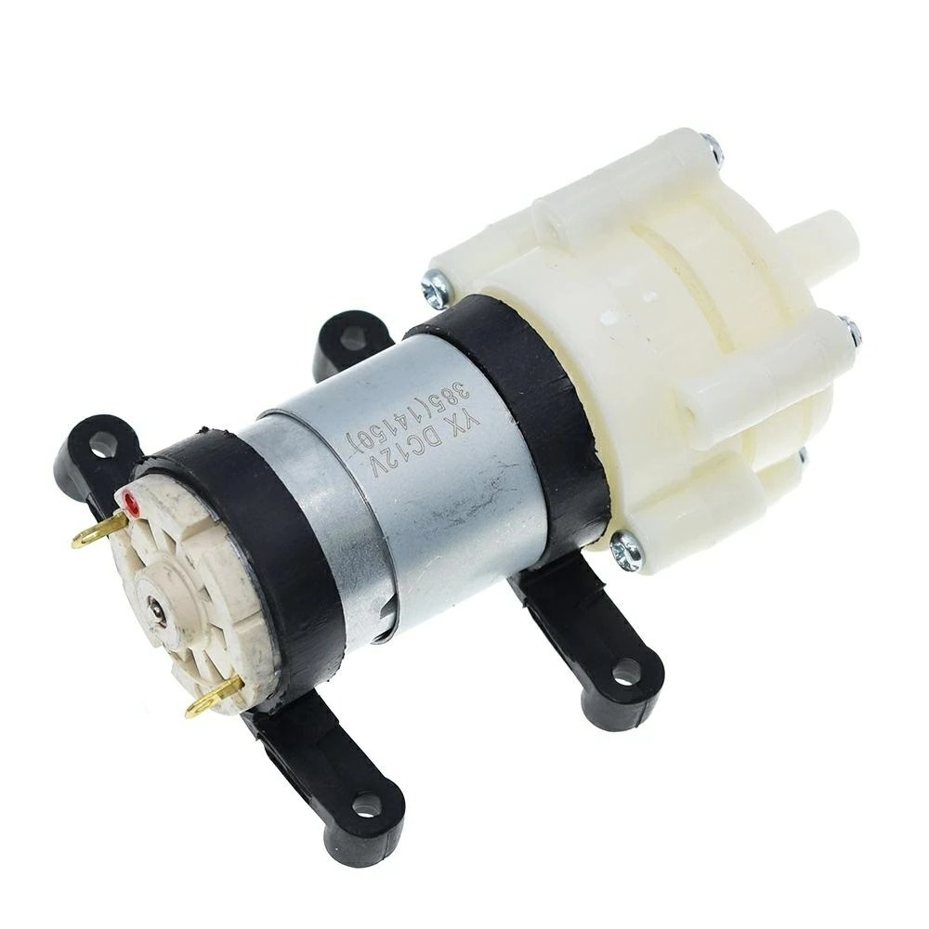
FUNCTIONS : WATERING
HARDWARE – SIDE CODE
HARDWARE
void Pump()
{
digitalWrite(WaterPump, isPumpActive);
}
else if (data == "0xC")
{
isPumpActive = !isPumpActive;
if(isPumpActive == 1)
{
SerialBT.println("Pump is Activated");
}
else
{
SerialBT.println("Pump is Deactivated");
}
}
Pump
SOFTWARE– SIDE CODE
ButtonDesign(
text1: 'Watering',
iconData: FontAwesomeIcons.droplet,
text2: 'Watering Started',
onPressed: () {
sendMessage("0xC");
},
),

Slide 12
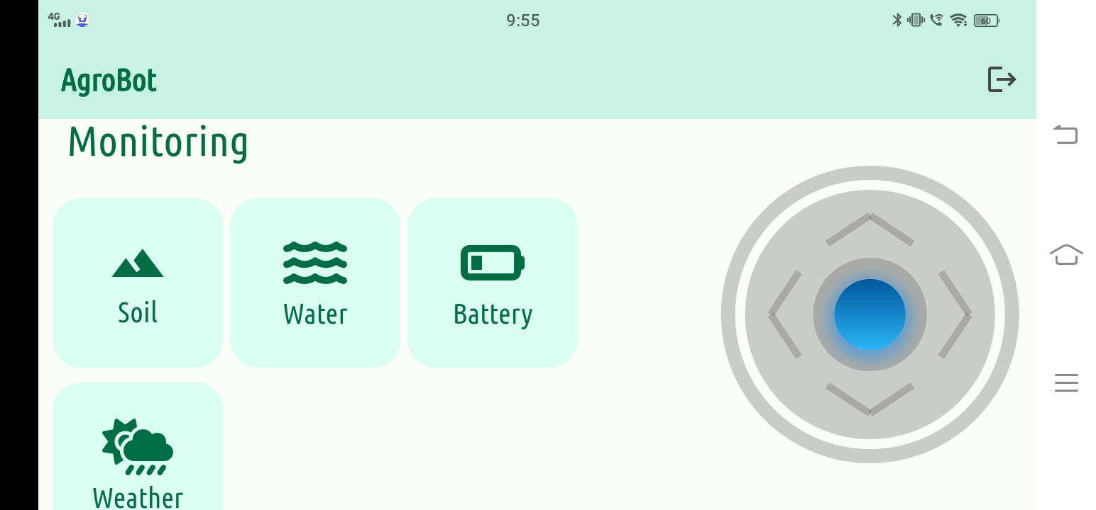
MONITORING

Slide 13
MONITORING : SOIL
SOFTWARE – SIDE CODE
void sendMessageToDevice(String msg) {
String message = msg;
if (widget.connection != null) {
widget.connection!.output.add(utf8.encode(message));
widget.connection!.output.allSent.then((_) {
// Message sent successfully
debugPrint('Message sent: $message');
_receiveData(); // Call subscribe method after message is sent
}).catchError((error) {
// Error occurred while sending message
debugPrint('Error sending message: $error');
});
} else {
// Connection is null, handle accordingly
debugPrint('Bluetooth connection is not available');
}
void _receiveData(){
_ receive?.cancel();
_receive = widget.connection!.input!.listen((List<int> data) {
final receivedString = utf8.decode(data);
String soilMoisture = parts;
}
if (soilMoisture >= 0.0 && soilMoisture <= 100.0) {
Soil(soilMoisture: soilMoisture);
}

Slide 14
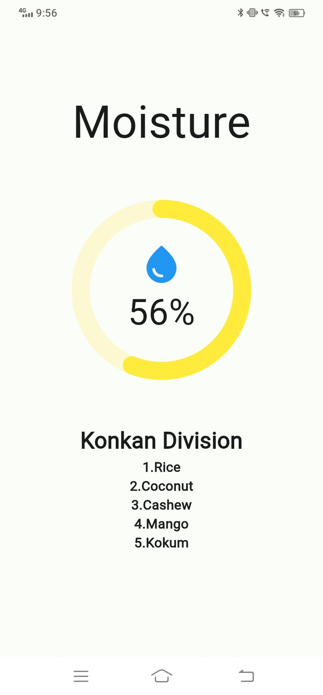
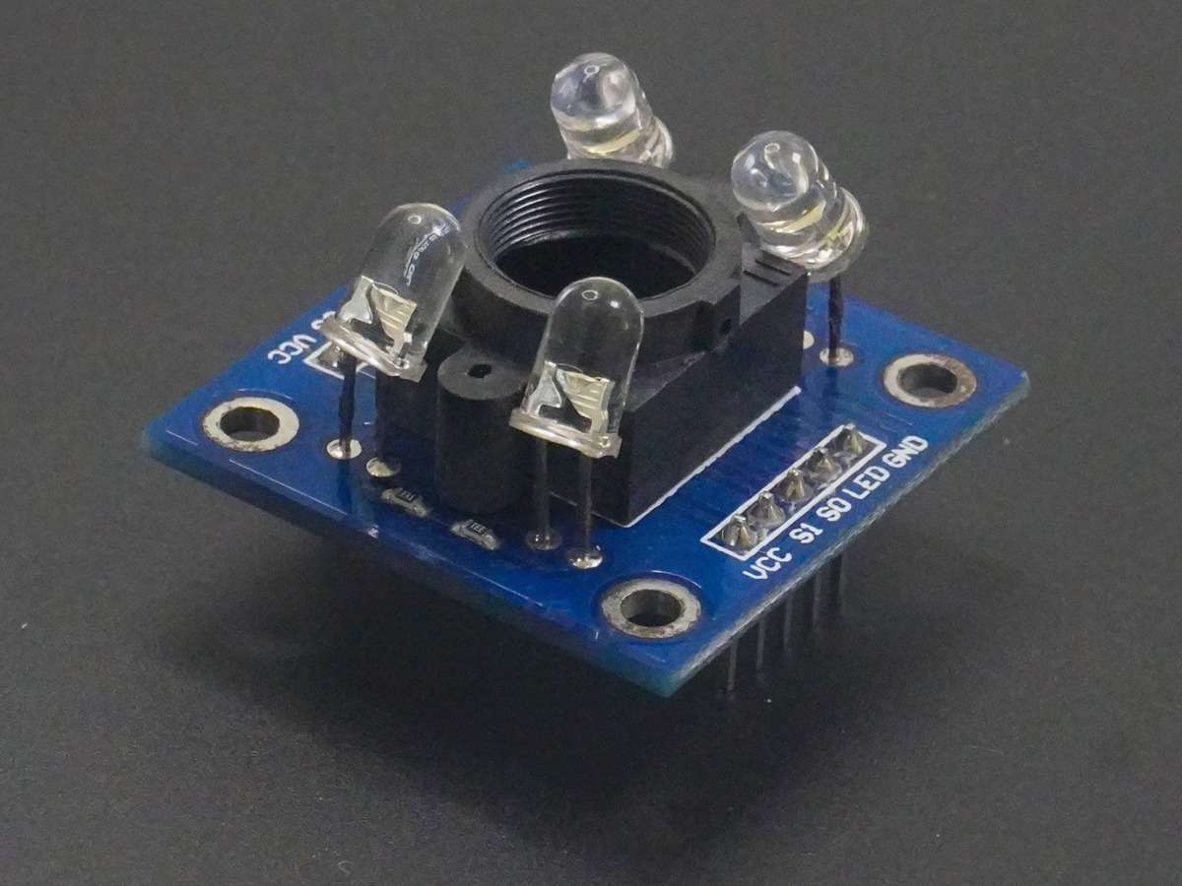
MONITORING : SOIL
HARDWARE – SIDE CODE
HARDWARE
GUI
else if (data == "0xS") {
redPW = getRedPW();
redPW = redPW / 1000;
SerialBT.println(redPW);
Serial.println("Soil Moisture Sent");
}
TCS3200 Color Sensor
int getRedPW() {
int PW;
PW = pulseIn(sensorOut, LOW);
return PW;
}

Slide 15
MONITORING : WATER QUALITY
SOFTWARE – SIDE CODE
void sendMessageToDevice(String msg) {
String message = msg;
if (widget.connection != null) {
widget.connection!.output.add(utf8.encode(message));
widget.connection!.output.allSent.then((_) {
// Message sent successfully
debugPrint('Message sent: $message');
_receiveData(); // Call subscribe method after message is sent
}).catchError((error) {
// Error occurred while sending message
debugPrint('Error sending message: $error');
});
} else {
// Connection is null, handle accordingly
debugPrint('Bluetooth connection is not available');
}
void _receiveData(){
_ receive?.cancel();
_receive = widget.connection!.input!.listen((List<int> data) {
final receivedString = utf8.decode(data);
String waterQuality = parts;
}
if (waterQuality>= 0.0 && waterQuality <= 100.0) {
Water(waterQuality : waterQuality);
}

Slide 16
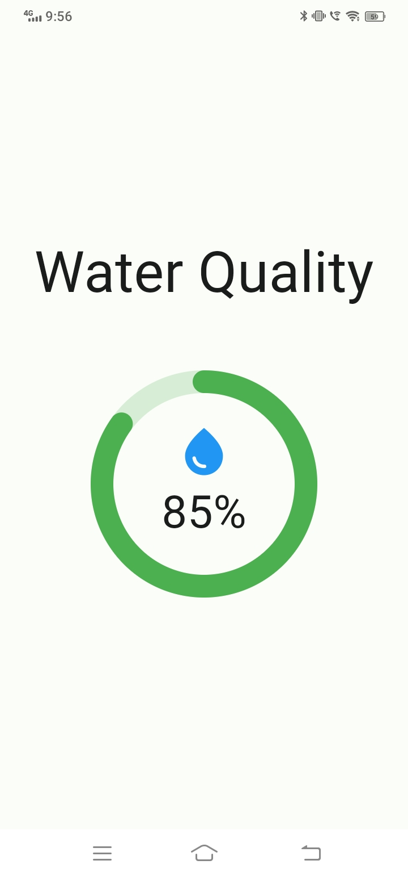
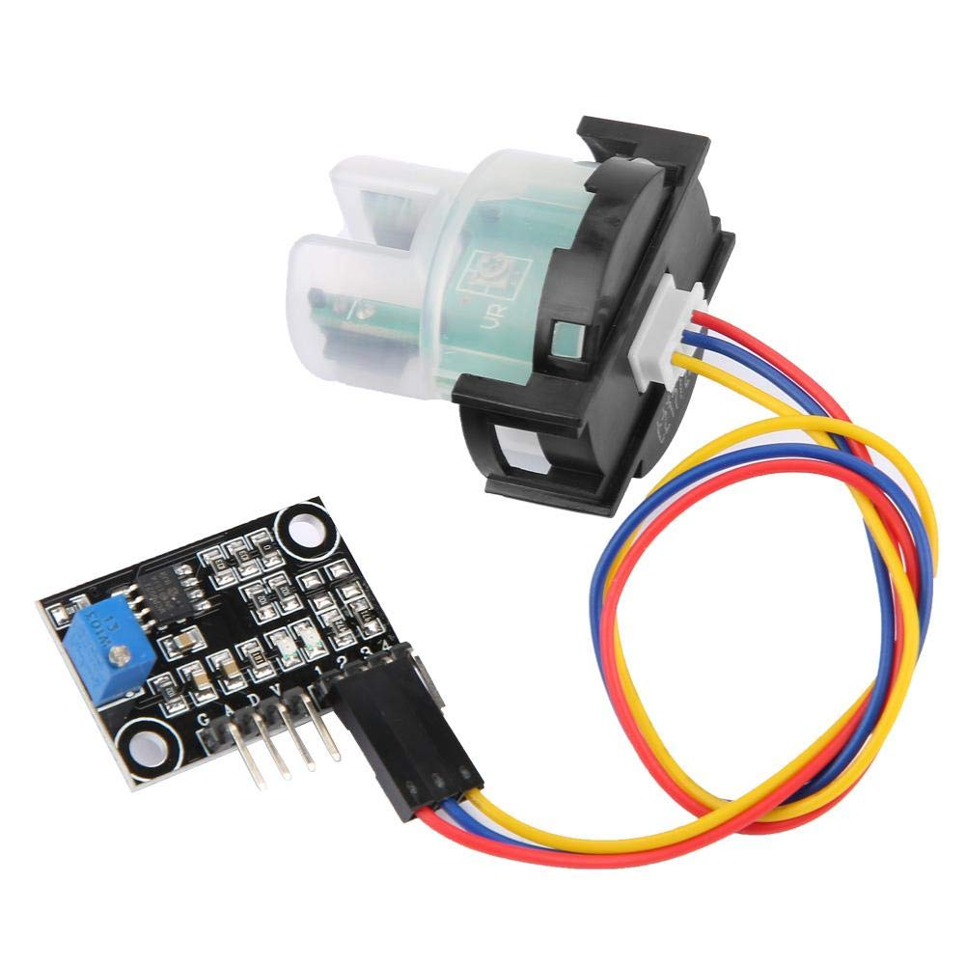
MONITORING : WATER QUALITY
HARDWARE – SIDE CODE
HARDWARE
GUI
if (data == "0xW"){
SerialBT.println(QowValue);
Serial.println("Water Quality Sent");
Serial.println(QowValue);
}
Turbidity Sensor
void turbidity()
{
sensorValue = analogRead(QosSens);
QowValue = sensorValue * (3.3 / 4095.0); //Analog to Digital
}

Slide 17
MONITORING : BATTERY
SOFTWARE – SIDE CODE
void sendMessageToDevice(String msg) {
String message = msg;
if (widget.connection != null) {
widget.connection!.output.add(utf8.encode(message));
widget.connection!.output.allSent.then((_) {
// Message sent successfully
debugPrint('Message sent: $message');
_receiveData(); // Call subscribe method after message is sent
}).catchError((error) {
// Error occurred while sending message
debugPrint('Error sending message: $error');
});
} else {
// Connection is null, handle accordingly
debugPrint('Bluetooth connection is not available');
}
void _receiveData(){
_ receive?.cancel();
_receive = widget.connection!.input!.listen((List<int> data) {
final receivedString = utf8.decode(data);
String battery= parts;
}
if (battery>= 0.0 && battery<= 100.0) {
Battery(battery:battery);
}

Slide 18
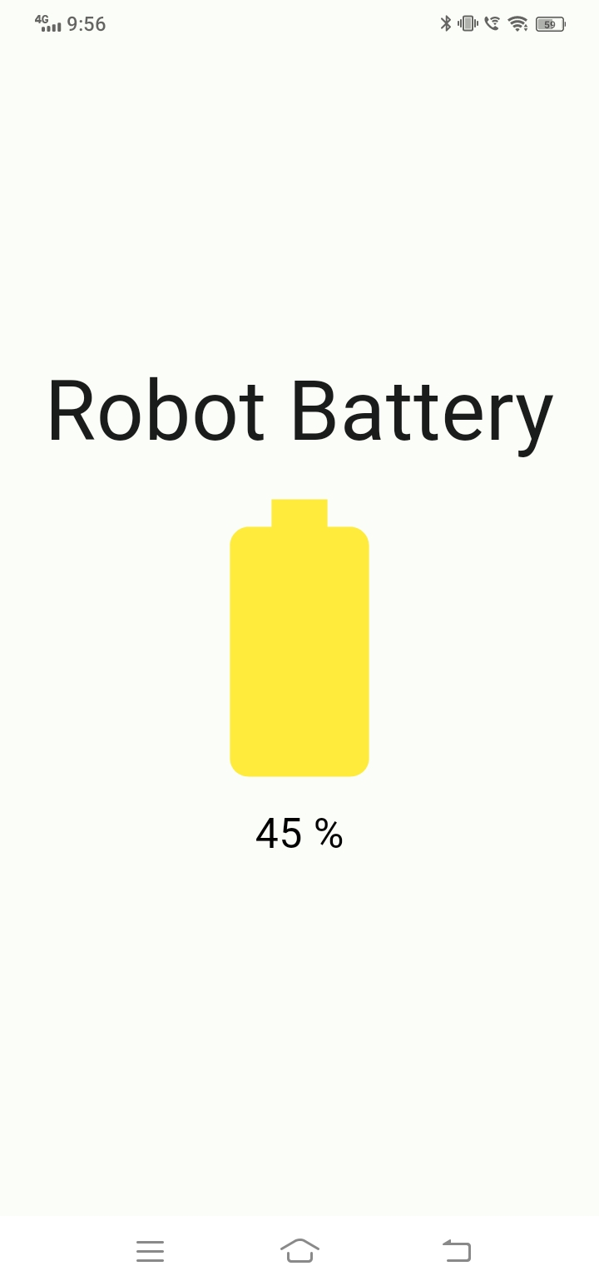
MONITORING :BATTERY
HARDWARE – SIDE CODE
GUI
void getbattvolt()
{
val = analogRead(battpin);//reads the analog input
Vout = (val * 3.2974) / 4095.00; // formula for calculating voltage out i.e. V+, here 5.00
Vin = Vout / (R2/(R1+R2));
battvolt = Vin;
}

Slide 19
MONITORING :WEATHER
SOFTWARE – SIDE CODE
const OPENWEATHER_API_KEY="a906a341824626680a97cd061a45d373";
Future<void> _getLocationAndWeather() async {
try {
Position position = await Geolocator.getCurrentPosition(
desiredAccuracy: LocationAccuracy.high);
List<Placemark> placemarks = await placemarkFromCoordinates(
position.latitude, position.longitude);
setState(() {
_location = '${placemarks.first.locality}, ${placemarks.first.administrativeArea}';
});
_fetchWeather(position.latitude, position.longitude);
} catch (e) {
setState(() {
_location = 'Error fetching location';
});
}
}
Future<void> _fetchWeather(double latitude, double longitude) async {
Weather? weather = await _wf.currentWeatherByLocation(latitude, longitude);
setState(() {
_weather = weather;
});
_showPopupMessage(getIrrigationRecommendation());
}
String getIrrigationRecommendation() {
if (_weather != null && _weather!.weatherDescription != null) {
String weatherDescription = _weather!.weatherDescription!.toLowerCase();
if (weatherDescription.contains('rain')) {
return 'Dont Irrigate crops, Rainy conditions detected.';
} else if (weatherDescription.contains('clear') ||
weatherDescription.contains('sunny')) {
return "Irrigate your crops. Sunny conditions.";
} else if (weatherDescription.contains('smoke')) {
return 'Irrigate your crops. Smoke detected.';
} else if (weatherDescription.contains('cloud')) {
return 'Monitor soil moisture. Cloudy conditions.';
}
}
return 'No specific irrigation recommendation at the moment.';
}
void _showPopupMessage(String message) {
showDialog(
context: context,
builder: (BuildContext context) {
return AlertDialog(
content: Text(message),
);
},
);

Slide 20
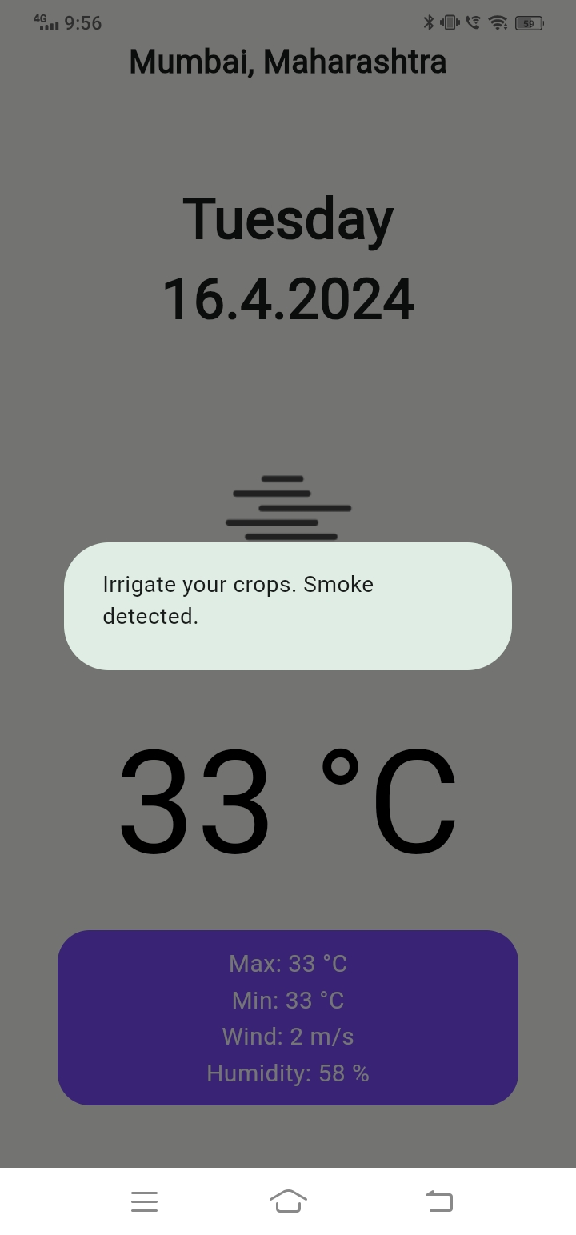
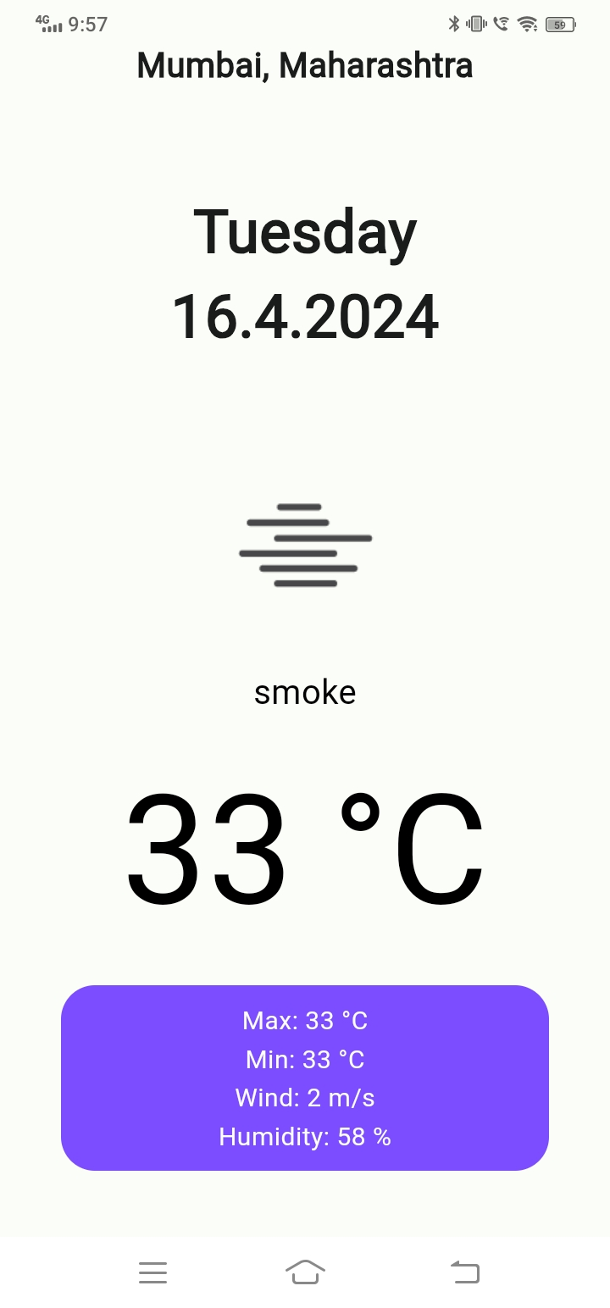
Future.delayed(const Duration(seconds: 10), () {
Navigator.of(context).pop();
});
}
Text(
_location,
style: const TextStyle(fontSize: 20, fontWeight: FontWeight.bold),
),
SizedBox(
height: MediaQuery.of(context).size.height * 0.08,
),
_dateTimeInfo(),
SizedBox(
height: MediaQuery.of(context).size.height * 0.05,
),
_weatherIcon(),
SizedBox(
height: MediaQuery.of(context).size.height * 0.02,
),
_currentTemp(),
SizedBox(
height: MediaQuery.of(context).size.height * 0.02,
),
_extraInfo(),
SizedBox(
height: MediaQuery.of(context).size.height * 0.02,
),
GUI

Slide 21
ANALYSIS: CROP
SOFTWARE – SIDE CODE
Future<void> _pickImage(ImageSource source) async {
final pickedFile =
await ImagePicker().pickImage(source: source, imageQuality: 50);
if (pickedFile != null) {
setState(() {
_selectedImage = File(pickedFile.path);
});
}
}
detectDisease() async {
setState(() {
detecting = true;
});
try {
diseaseName =
await apiService.sendImageToGPT4Vision(image: _selectedImage!);
} catch (error) {
_showErrorSnackBar(error);
} finally {
setState(() {
detecting = false;
});
}
}
showPrecautions() async {
setState(() {
precautionLoading = true;
});
try {
if (diseasePrecautions == '') {
diseasePrecautions =
await apiService.sendMessageGPT(diseaseName: diseaseName);
}
_showSuccessDialog(diseaseName, diseasePrecautions);
} catch (error) {
_showErrorSnackBar(error);
} finally {
setState(() {
precautionLoading = false;
});
}
}

Slide 22
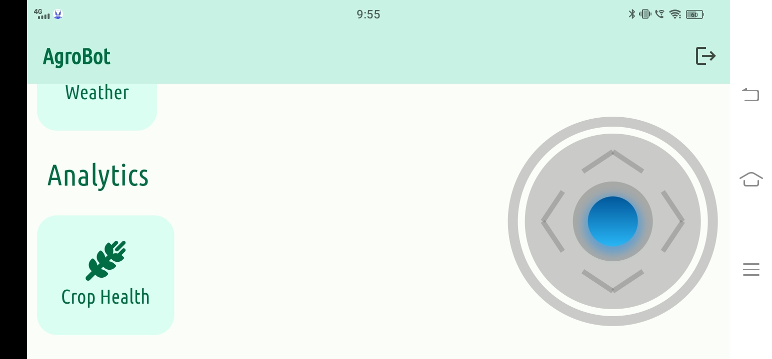
ANALYSIS: CROP

Slide 23
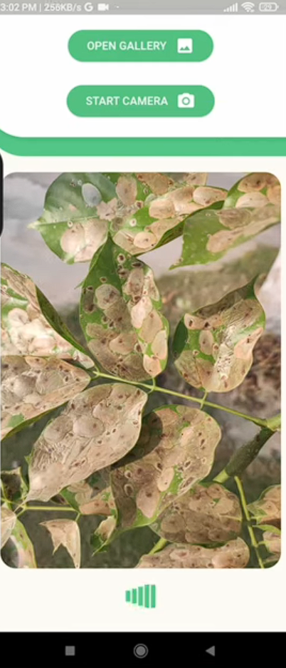
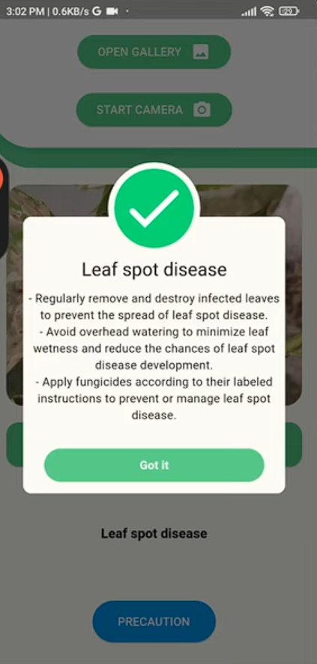
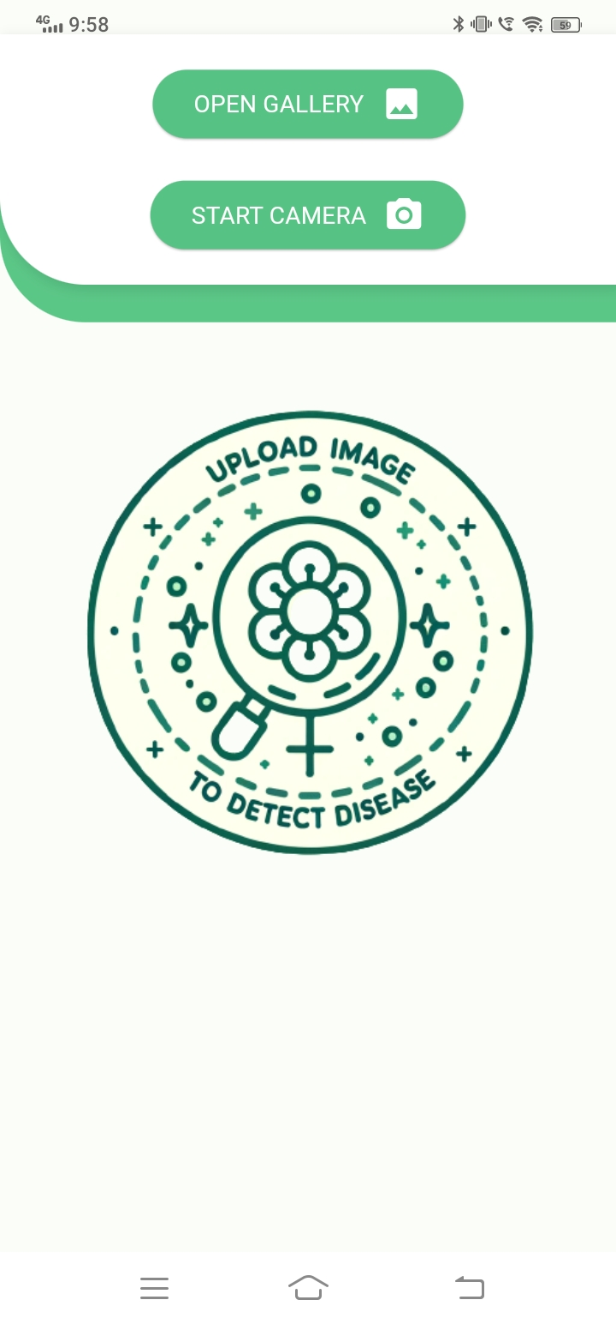
ANALYSIS: CROP

Slide 24
REFERENCES
https://www.researchgate.net/publication/283331223 Agriculture monitoring system A study
https://www.sciencedirect.com/science/article/pii/S2666285X2100090X
https://www.sciencedirect.com/science/article/pii/S2666154323003873
https://ieeexplore.ieee.org/document/7831342
https://www.researchgate.net/publication/372523093 Smart Sensing Technologies for Crop Health Monitoring and Disease Detection

Slide 25
THANK YOU

